Slide 1
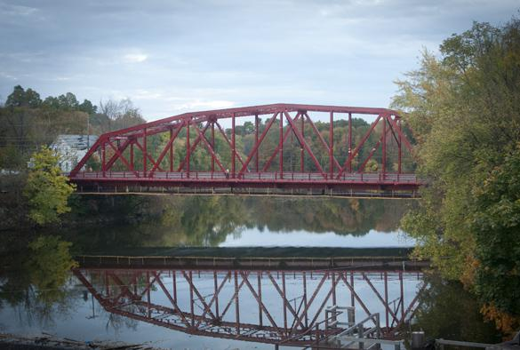
Welcome to Saugerties Jr. High School!
with Mr. Hasbrouck
email: ehasbrouck@saugerties.k12.ny.us

Slide 2
Mr. Hasbrouck’s Schedule
1st 7:45 - 8:28 | 2nd 8:32 - 9:13 | 3rd 9:17 - 9:58 | 4th 10:02 - 10:43 | 5th 10:47 - 11:28 | 6th 11:32 - 12:13 |  | 7th 12:51 - 1:32 | 8th 1:36 - 2:18 | 9th 2:22 - 3:00
Team C Meeting 613 | ELA 613 | Math 604 | Math 606 | Prep | Resource Room 305 | Lunch | ELA 613 | Resource Room 305 | Extra Help on: Mon Wed Thurs
Home Base: Room 514b
Phone: 845-247-6561 Extn: 2551
email: ehasbrouck@saugerties.k12.ny.us

Slide 3
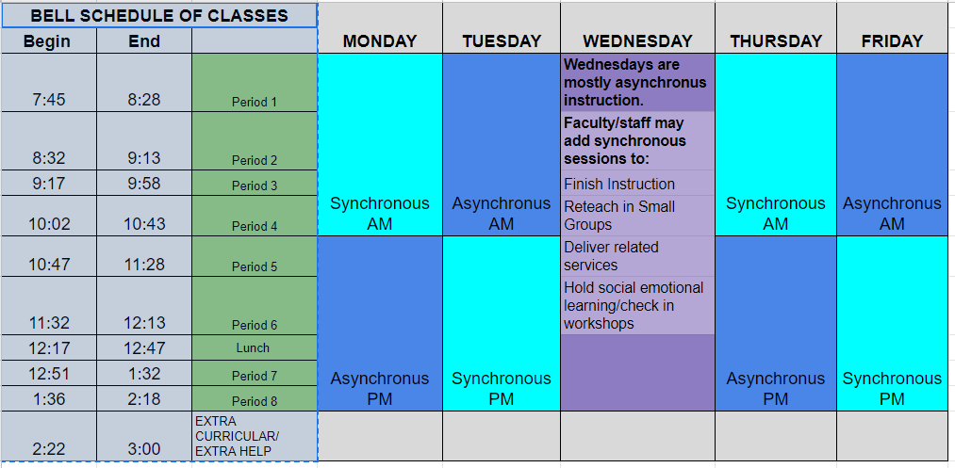

Slide 4

“We Got You…”
Team C
Mr. Vail: Math Mr. Hasbrouck: Special Education
Mrs. Keyser: English Mrs. Hufnagel: Teaching Assistant
Ms. Griffin: Science Ms. Frey: Teaching Assistant
Mr. Carpino: US History Ms. Weeks: Teaching Assistant

Slide 5
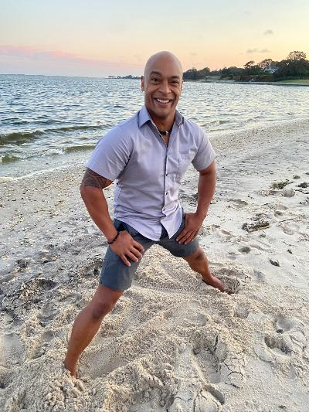
8th Grade TEAM C
Consultant Teacher
Case Manager
Modified Track Coach
Mr. Hasbrouck 2020-21

Slide 6




Mr. Hasbrouck
BFA: Art/ Illustration
MA: Special Education

Slide 7
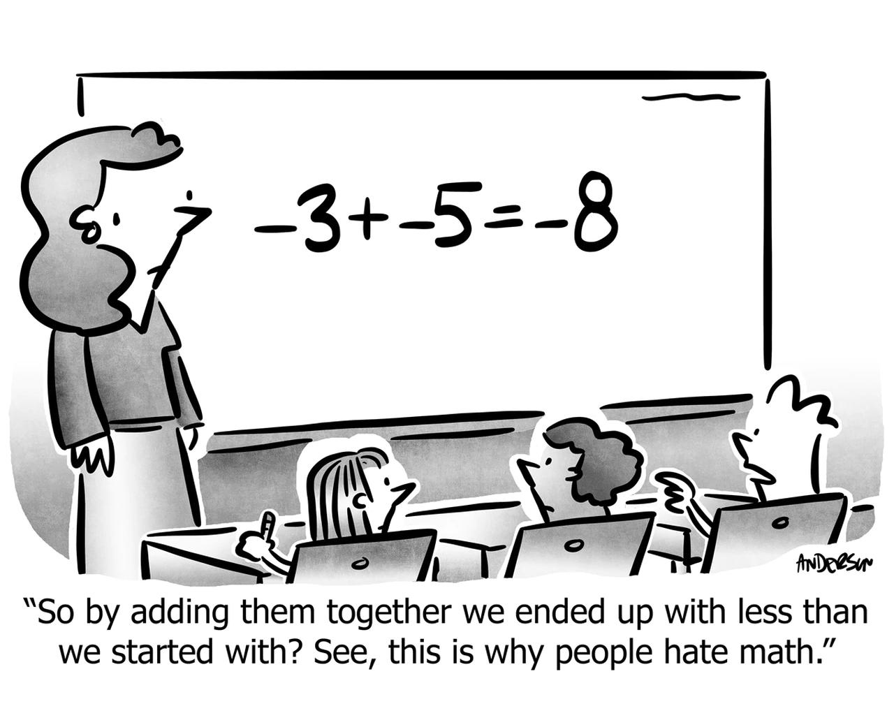
3rd Period: Principles of Math
with Mr. Hasbrouck
Approaching Math...
I must identify the problem.
I will create a way of solving it.
I will compute the solution.
I will ask... “Is the solution reasonable?”

Slide 8
